Slide 1

KEEP YOUR FEET ON THE GROUND
THE REALITY OF EARTHQUAKES
By Ilaria Cannava
THE DEVELOPER ACADEMY - DATA SCIENCE BOOTCAMP
JANUARY 2024
NAMAZU THE EARTHSHAKER, NAMAZU
BY BENJAMINFLOUW

Slide 2
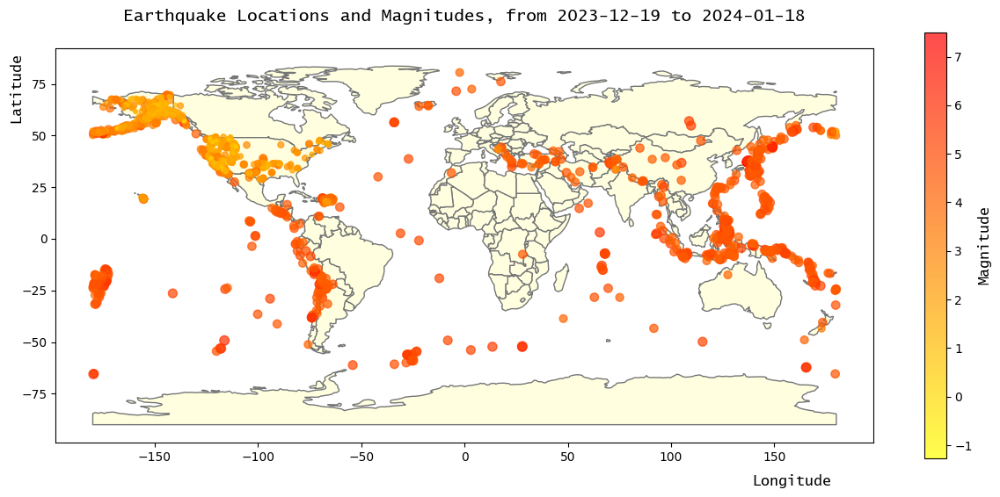
WHY AND WHERE?
TETONICS PLATES THEORY
TOTAL EARTHQUAKES FOR THE TIME PERIOD = 8886
THE DEVELOPER ACADEMY - DATA SCIENCE BOOTCAMP -JANUARY 2024
PAGE 01

Slide 3
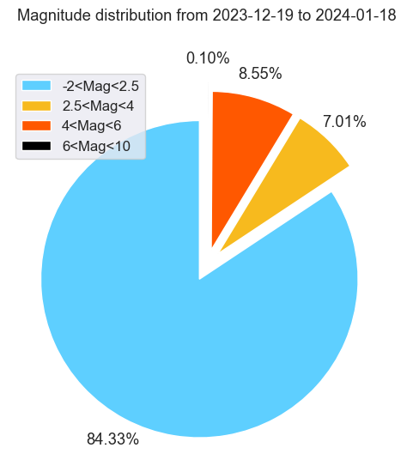
MAGNITUDE
8<MAG<9 AND ABOVE
GREAT EARTHQUAKE
NEAR TOTAL DESTRUCTION
MASSIVE LOSS OF LIFE
7<MAG<8
MAJOR EARTHQUAKE
SEVERE ECONOMIC IMPACT
LARGE LOSS OF LIFE
6<MAG<7
STRONG EARTHQUAKE
DAMAGE, LOSS OF LIFE
5<MAG<6
MODERATE EARTHQUAKE
PROPERTY DAMAGE
4<MAG<5
LIGHT EARTHQUAKE
SOME PROPERTY DAMAGE
MAG<4 MINOR EARTHQUAKE
FELT BY HUMANS
THE DEVELOPER ACADEMY - DATA SCIENCE BOOTCAMP -JANUARY 2024
PAGE 02

Slide 4
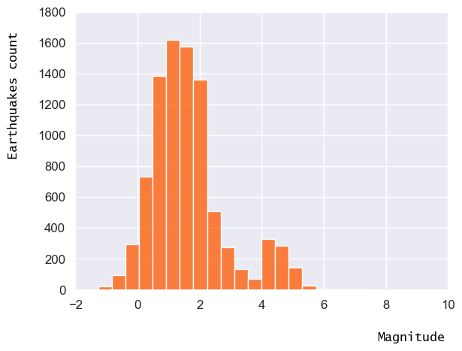
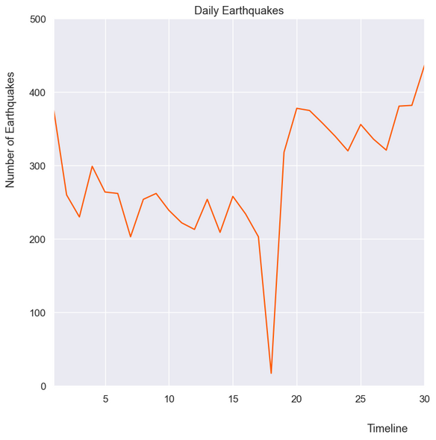
SOME KEY FACTS
CIRCA 15 EARTQUAKES OF MAG>=7 PER YEAR
MILLIONS OF EARTHQUAKES PER YEAR
QUASI-RANDOM PHENOMA
IS EARTHQUAKES ACTIVITY INCREASING?
IS MAGNITUDE DISTRIBUTION CHANGING?
THE DEVELOPER ACADEMY - DATA SCIENCE BOOTCAMP -JANUARY 2024
PAGE 03

Slide 5
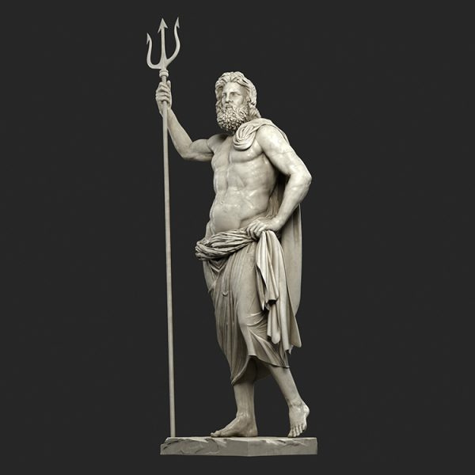
SOURCES
Data set from Kaggle.com at Earthquakes data set:
<https://www.kaggle.com/datasets/farazrahman/earthquake>
Info on Earthquakes from British Geological Survey:
<https://www.bgs.ac.uk/discovering-geology/earth-hazards/earthquakes/what-causes-earthquakes/>
Namazu Illustration :
<https://www.deviantart.com/benjaminflouw/gallery>
CONTACT
Ilaria Cannava
E-mail
ilaria.cnnv@gmail.com
POSEIDON
Poseidon, marble statue from Melos
2nd century BCE; in the National Archaeological Museum, Athens
Alinari/Art Resource, New York
THE DEVELOPER ACADEMY - DATA SCIENCE BOOTCAMP -JANUARY 2024
PAGE 04

